Slide 1
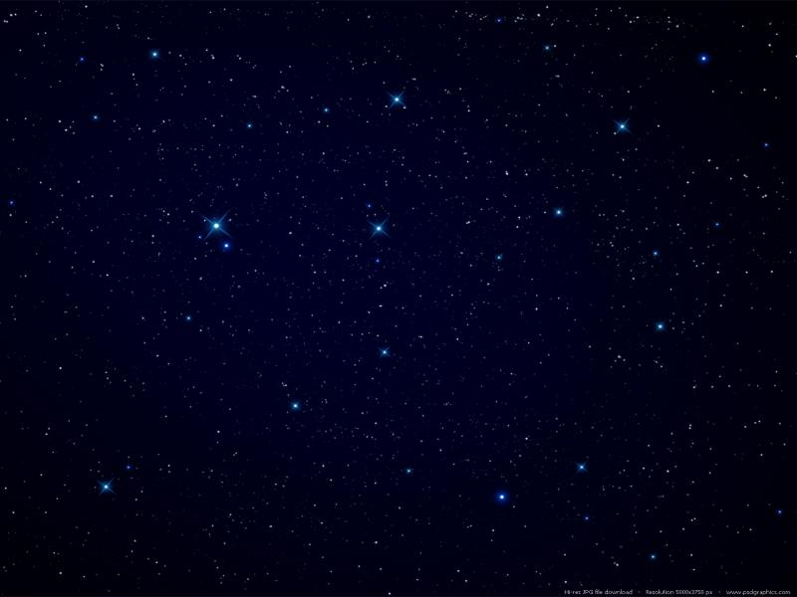

team MINDACTIVITY
2022 Demo Day

Slide 2
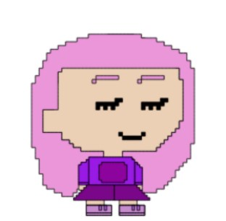
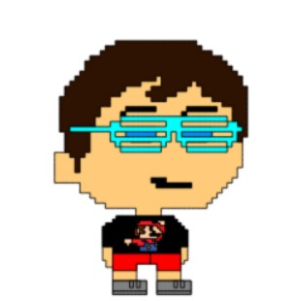
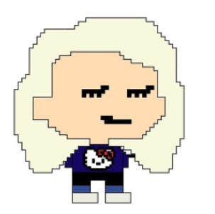
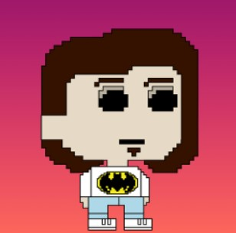
Meet the Team
Sadie
Ed
Philip
Anastasia

Slide 3
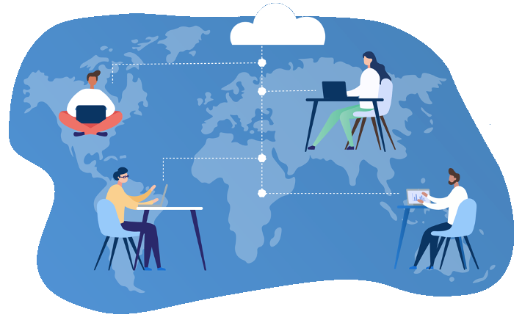

PROBLEM
How to enhance the remote experience of a bootcamper.
What can help them with the vast amount of learning?
What do they need?
What problem might they have that your application could solve for them?
How can you get into the mindset of your user and keep them at the centre of your problem-solving?

Slide 4


Bootcamp Burnout

Slide 5
MINDFULLNESS + PRODUCTIVITY = MINDACTIVITY

Slide 6
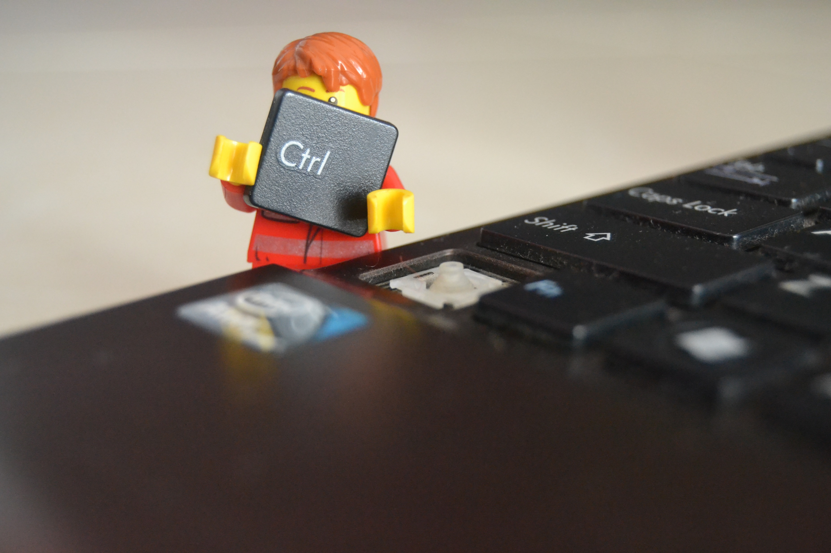
SOLUTION

Slide 7
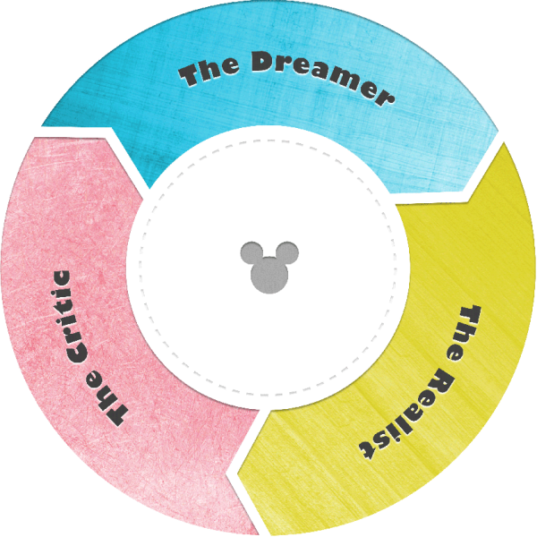
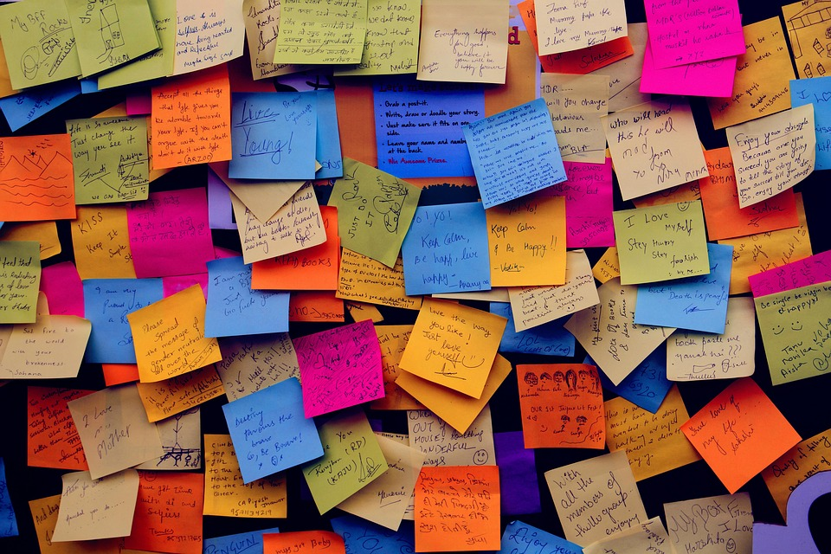
JOURNEY IDEATION & RESEARCH

Slide 8
Disney Ideation
Dreamer | Realist | Critic
Organisation Tools | Link to class notes, link to videos | No experience with audio API
Resources Access | Daily planner | Time constraints
Timer with gentle affirmations | ARIA html | When in doubt, stretch goal it
Personal assistant/tutor | Accessibility tools | More research needed
#Istruggletoo | API for affirmations | No experience with animations
Blog feature | Heroku database | External API vs Internal API
To-do List | High contrast website | Blog requires more than one user
Reminder | Nature sounds | Login authentication issues
Link App to Apple Watch | Mental health resources | Lack of originality

Slide 9
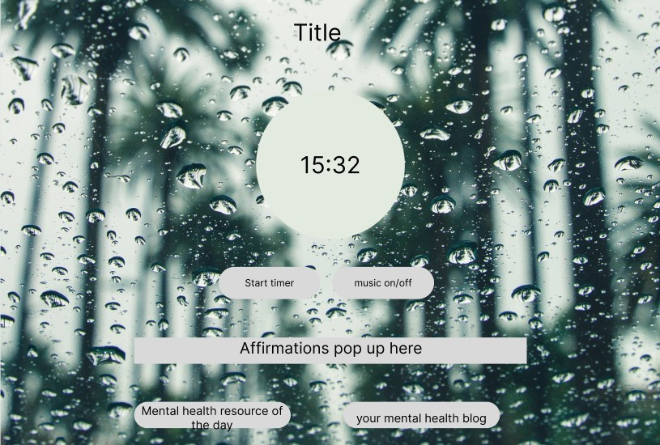

Slide 10
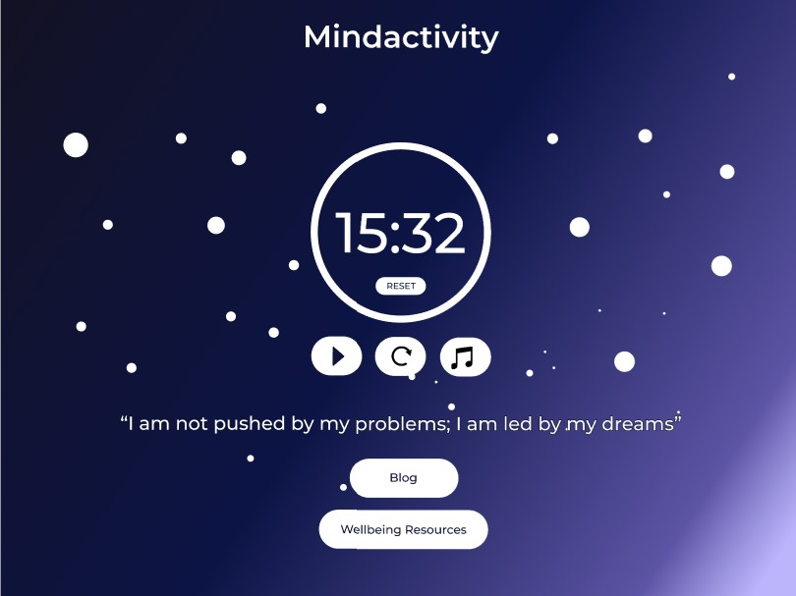

Slide 11
USER SURVEY
Flow chart

Slide 12
User Personas
Name: John Age: 55
Gender: male
Education: MBA
Previous Occupation: Director/Employee Assistant Div.
Extroversion Type: Extrovert
Level of physical activity: Sedentary
As an extroverted bootcamper, I want an app that includes an interactive blog feature so that I can connect with other bootcampers.
As a bootcamper with low level of physical activity, I want to use a stress relief app with a timer,
So that I can use it for exercise as well as meditation

Slide 13
As an introverted bootcamper, I want an app which includes a meditation timer, so that I can spend some time in silence with my own mind
Name: Esther
Age: 30
Gender: female
Education: Psychology A-Levels
Previous Occupation: self-employed
Extroversion Type: Introvert
Level of physical activity: Quite active
As a bootcamper with a high activity level, I want a stress relief app
So that I can have relaxing downtime

Slide 14
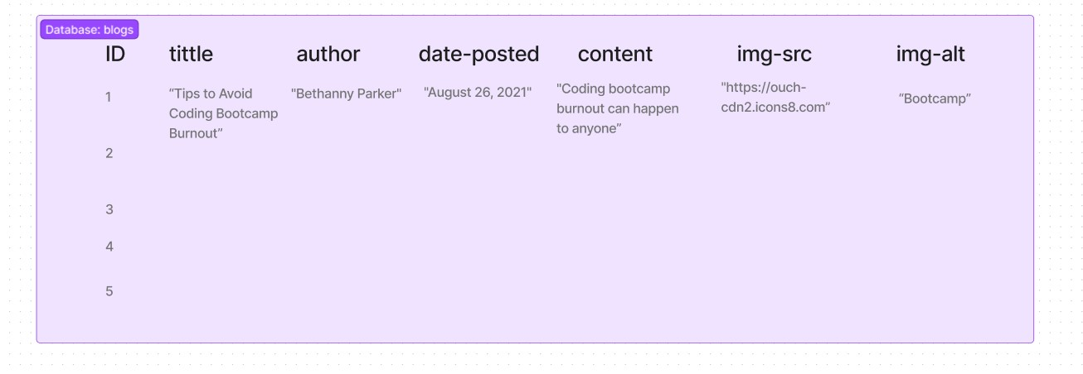
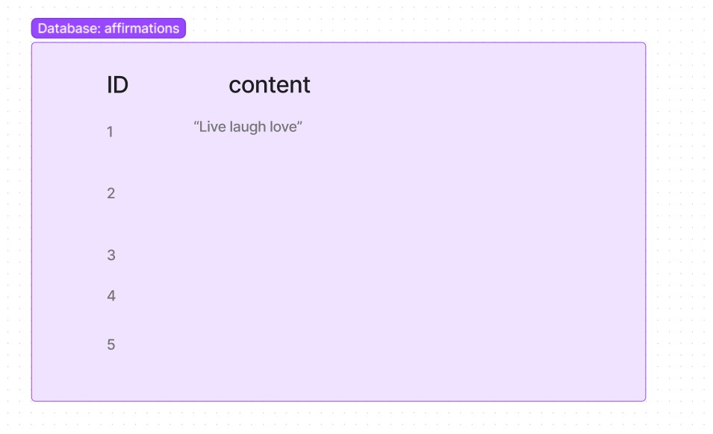
Database Structure

Slide 15
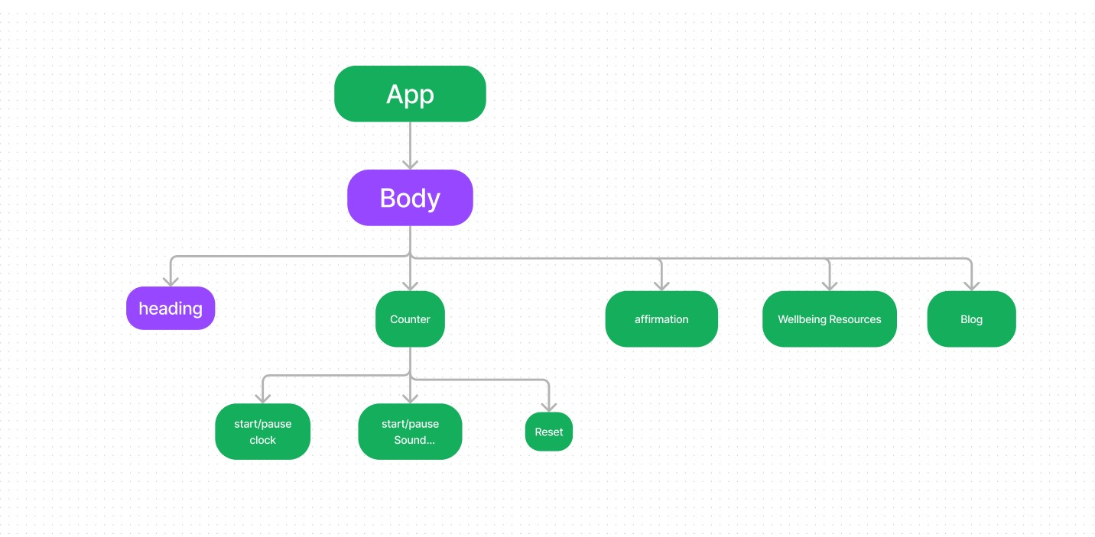
Component Tree

Slide 16
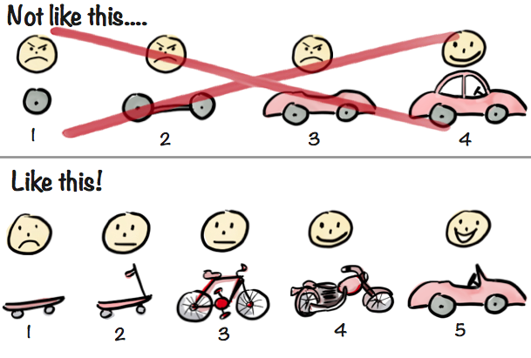
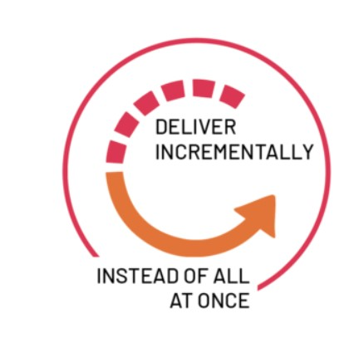
Agile Methodology

Slide 17
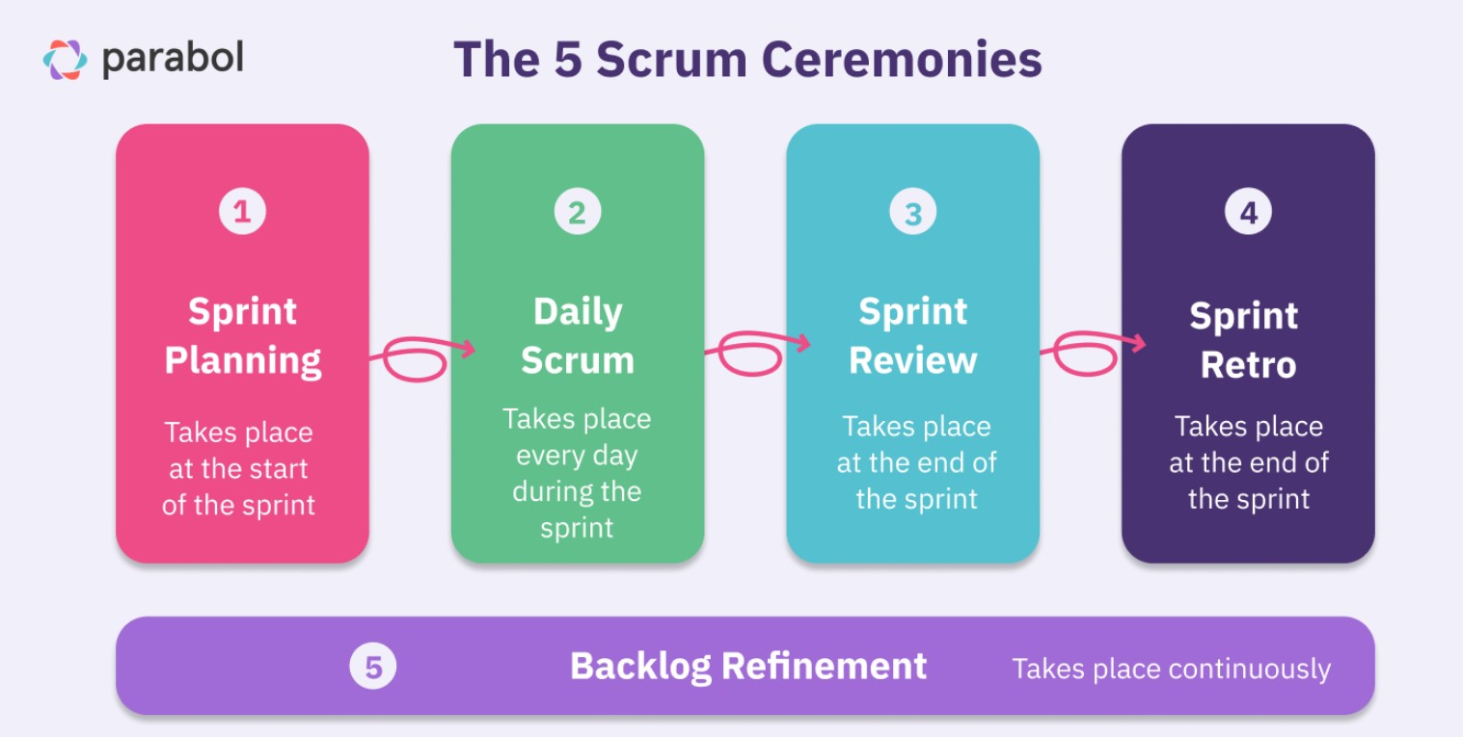
Daily Scrum Ceremonies

Slide 18
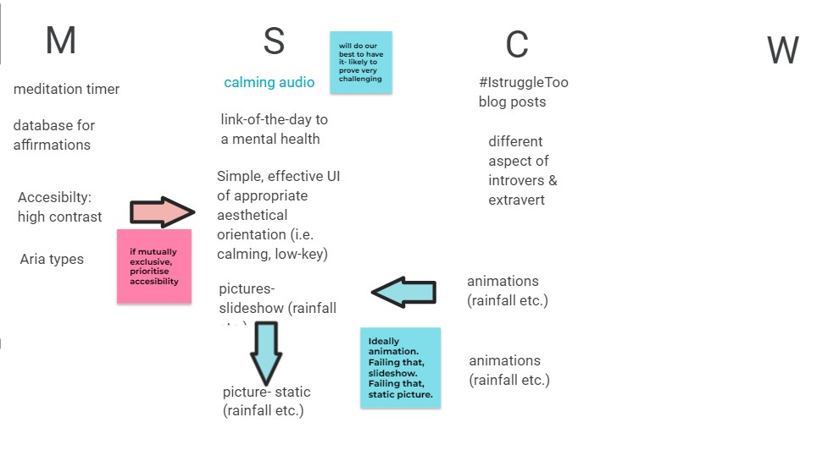
MoSCoW to MVP

Slide 19


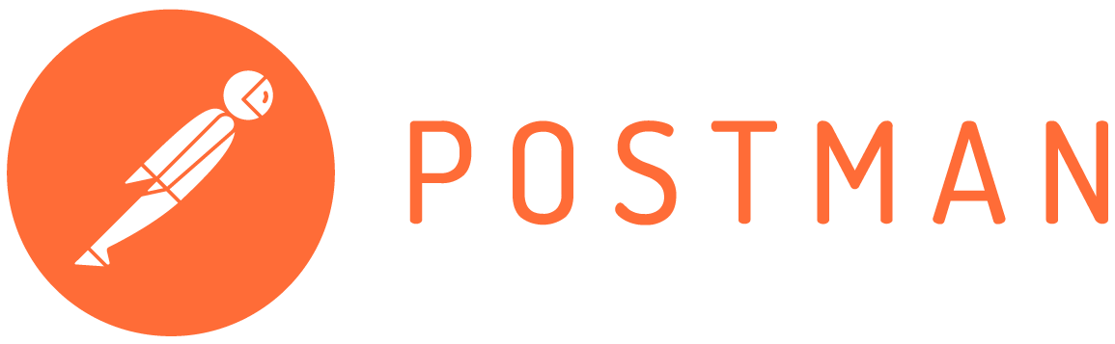
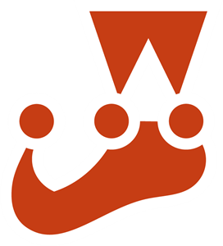






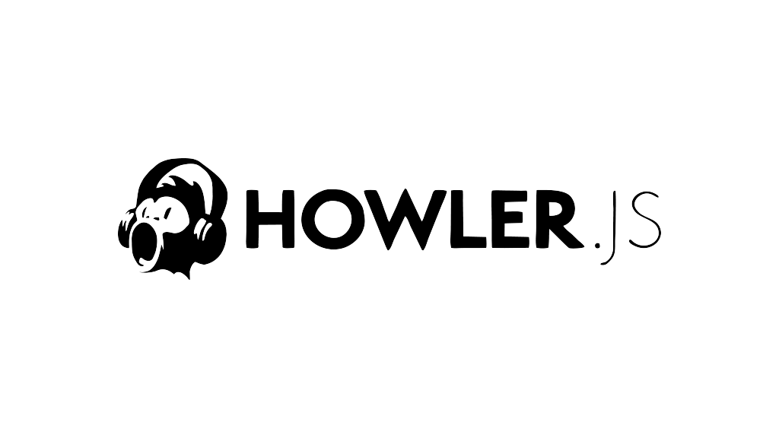

Tech Stack
Front End
Back End
Testing

Slide 20
Future Implementations

Slide 21
Challenges

